Slide 1
Semantic Network and Content Analysis of COVID-19 Vaccine Related Social Media Text
Chad A. Melton¹, Jintae Bae², Olufunto A. Olusanya³, Jon Hael Brena⁴, Eun Kyong Shin², and Arash Shaban-Nejad^{1,3}
¹ Bredesen Center for Interdisciplinary Research and Graduate Education, University of Tennessee, Knoxville, TN, United States
²Korea University, Seoul, South Korea
³University of Tennessee Health Science Center-Oak-Ridge National Laboratory (UTHSC-ORNL) Center for Biomedical Informatics, Department of Pediatrics, College of Medicine, Memphis, TN, United States
⁴Sanger Institute, Cambridge, UK

Slide 2
Motivation
The COVID-19 pandemic fueled the most rapid vaccine development and distribution in history.
Misinformation/disinformation spread through social media.
Vaccine hesitancy→morbidities and untimely deaths.
~4 billion social media users → information gathering.
Network analysis, Sentiment Analysis, and Topic Modeling.
Public health messaging, education, digital interventions, and public health policies.

Slide 3
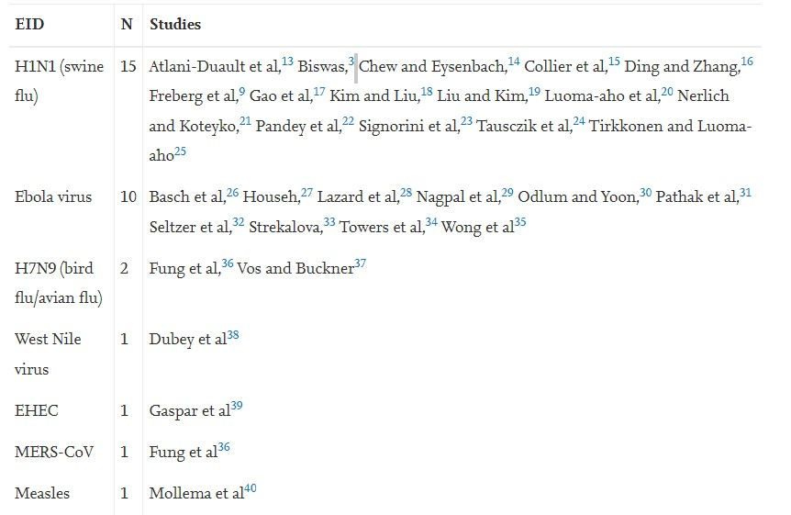
Background: Public health surveillance from social media during disease outbreaks.
Courtesy of Tang et al., (2018)

Slide 4
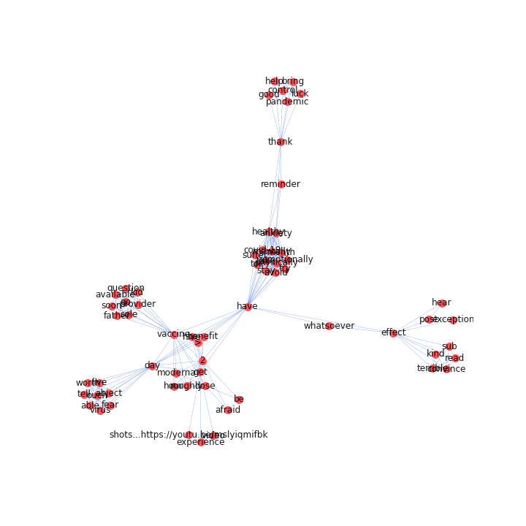
Background: Network Analysis
Network graph analysis has been used for a wide variety of problems across many scientific domains including (traffic routing, social relationships, logistics, cultural analysis, political ideology, financial markets, COVID comorbidity networks (Shin et al., 2021) and many more applications).
Computational semantic analysis has been used to explore clustering in news articles and Google reviews (Verimyev et al., 2019).
Until recently, the use of computational semantic network analysis regarding COVID-19 vaccines appears to be relatively unexplored to the best of my knowledge.
Luo et al., 2021 recently (Dec 2021) explored the differences of perceptions between Chinese and American cultures regarding the COVID-19 vaccines by semantic network analysis with Twitter and Weibo with Gelphi.

Slide 5
Methods: Data
Reddit: information-sharing social media platform.
Approximately 450 million total users (50% in the US).
Divided into topic-based communities called “subreddits”.
Community members typically adhere to a set of community regulations.
"upvote" or "downvote" on a post based on their opinion of the quality of that post and/or leave comments.
Heterogenous data set (e.g., Vaccines, CovidVaccine, CovidVaccinated, AntiVaxxers, vaxxhappened, antivaccine, conspiracy, conspiracytheories, NoNewNormal, conspiracy_commons, COVID19, COVID, and coronavirus for Melton et al 2021) .

Slide 6
Natural Language Processing Steps and Data Cleaning
PRAW: Python Reddit API Wrapper.
Data are queried for COVID-19 vaccine relevant terms and organized by date.
Tokenization: breaking up a stream of words into single indexes, punctuation marks, numbers and other discrete items. Example (“I want to go back to Costa Rica → “I”, “want”, “to”, “go”, “back”, “to”, “ Costa”, “Rica”.)
Normalization: Stemming-> changing a word to its base form (e.g., studying→study).
Stop words: removing determiners, conjunctions, and prepositions.

Slide 7
Methods: Semantic Network Analysis
Network analysis uses a graphical representation of nodes and edges to provide insight into data that may not be observable upon the surface.
Nodes represent tokenized words while Edges represent a connectedness between nodes.
Conducted with the Python library, Networkx.
Network Building Steps
Word cooccurrence network was created with nx.Graph().
Isolates removed.
Betweeness Centrality: measures the number of times a node lies on the shortest path between other nodes. (i.e., nodes bridge a network together. Ideal for communication networks).

Slide 8
Network Analysis
Final amalgamated dataset consisted of 31432 posts/comments authored by 20429 users between January 1, 2020, and Oct 31, 2021 with 1.2 million votes.
Betweenness Centrality network and Ego networks concentrated on the term “vaccine” was created for each month.
Temporal semantic network analysis to observe graph evolution over time.
Reddit data included (r/CovidVaccinated, r/Coronavirus, r/CovidVaccine, r/conspiracy_commons, r/COVID19_support, r/COVID19, r/AntiVaxxers, r/VACCINES, r/conspiracytheories, r/China_Flu, r/COVID19positive, r/conspiracy) with a total of 5.1 million users).

Slide 9
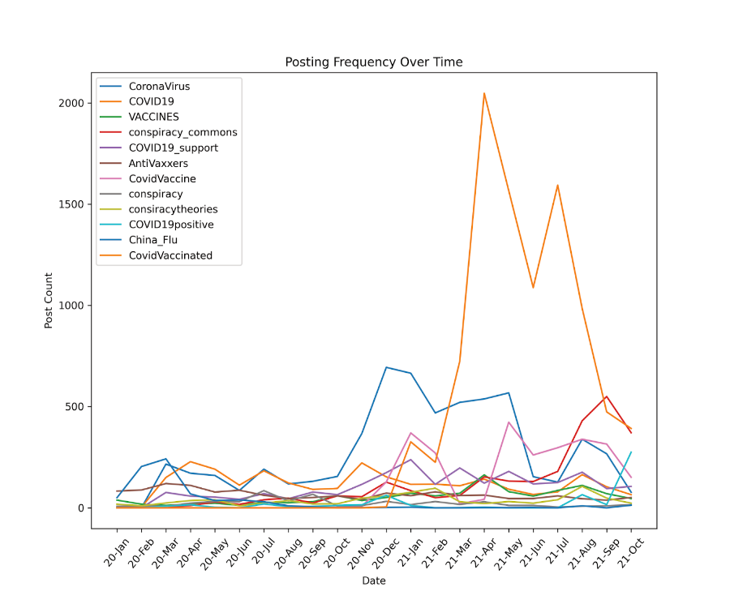
Posting frequency

Slide 10
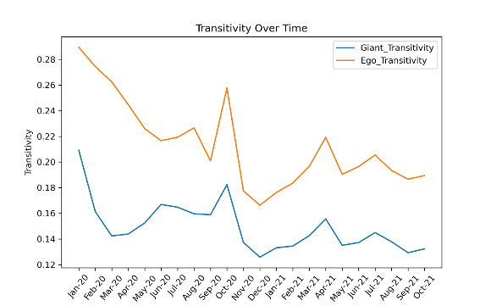
Transitivity

Slide 11
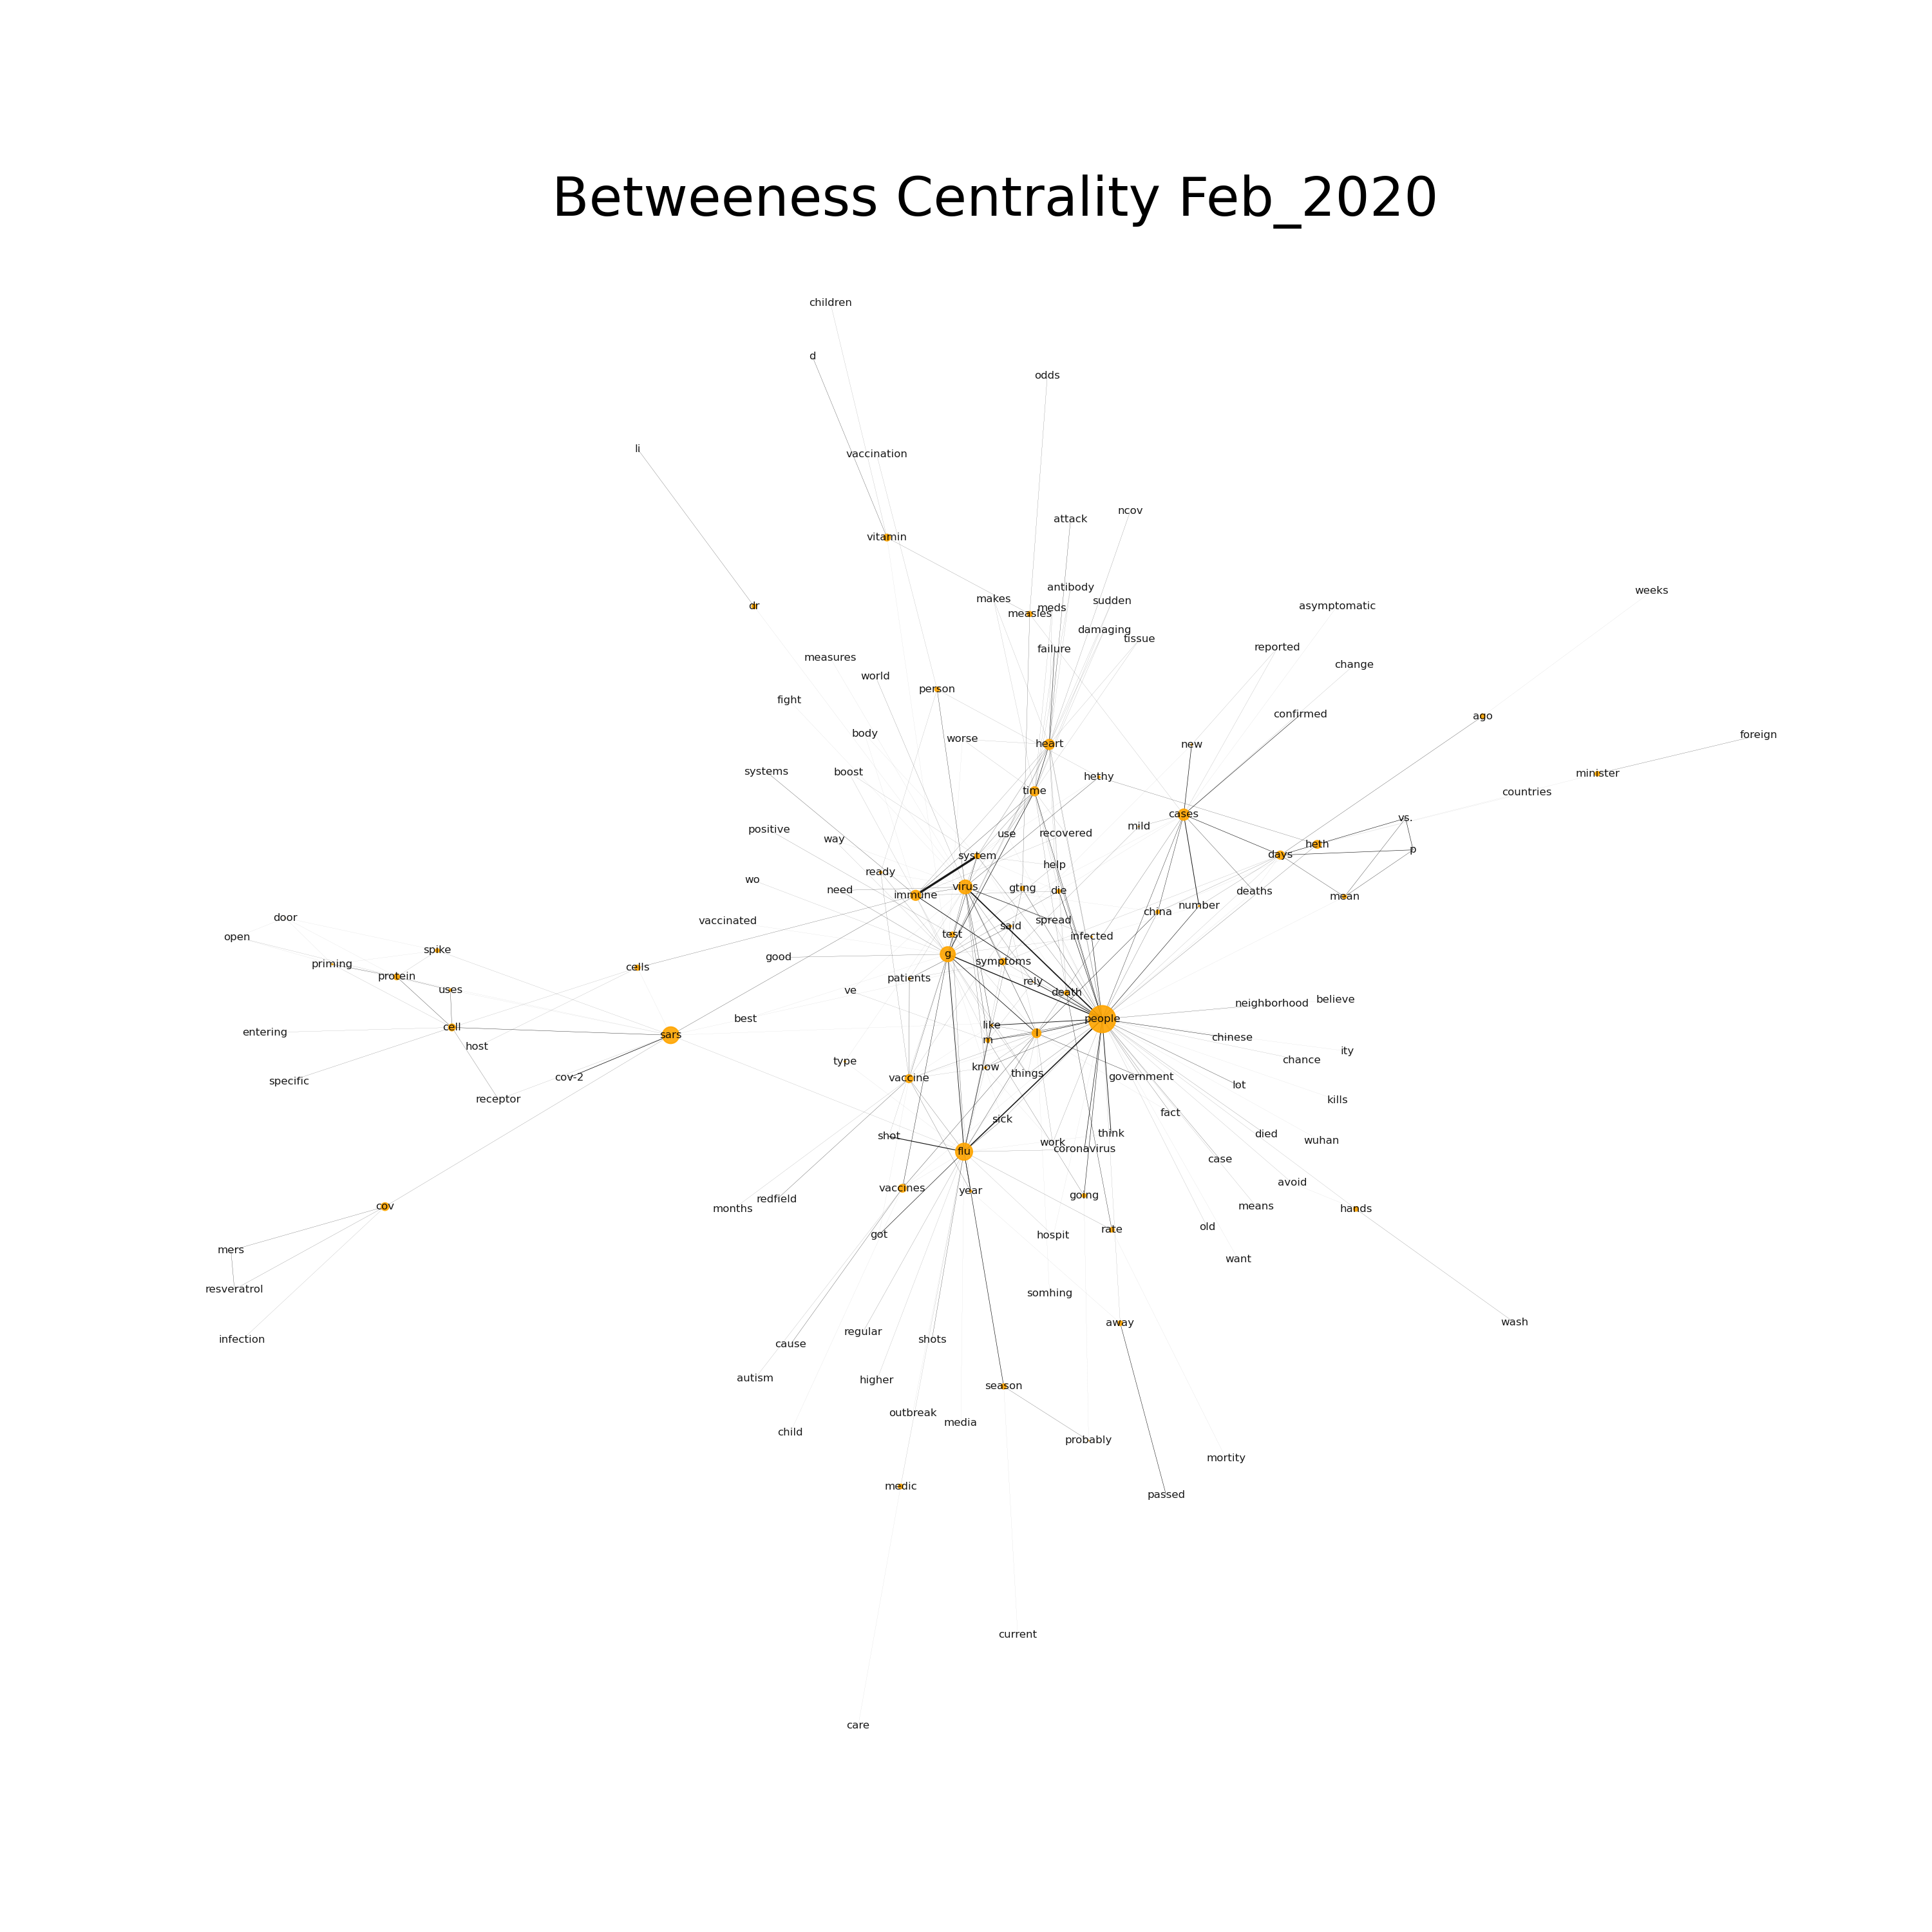
Betweenness Centrality: Feb 2020
Node | Centrality
people | 0.514751
flu | 0.201008
sars | 0.19399
g | 0.155384
virus | 0.131837
cases | 0.0862
heart | 0.07063
immune | 0.069135
time | 0.056011
l | 0.05182
days | 0.044496
vaccine | 0.043151
heth | 0.041925
vaccines | 0.040265
cov | 0.040173
cell | 0.031341
vitamin | 0.030593
symptoms | 0.026141
protein | 0.022785
system | 0.017771
cells | 0.017419
Betweenness Centrality for September 2020. Nodes are indicated by orange circles and edges are indicated lines. Node size is reflective of the weight and edge thickness indicative of interconnectedness between nodes.
Notes:
Here people is the most prevalent node. Some discussion with the hub nod “sars” and also the “flu” is mentioned.

Slide 12
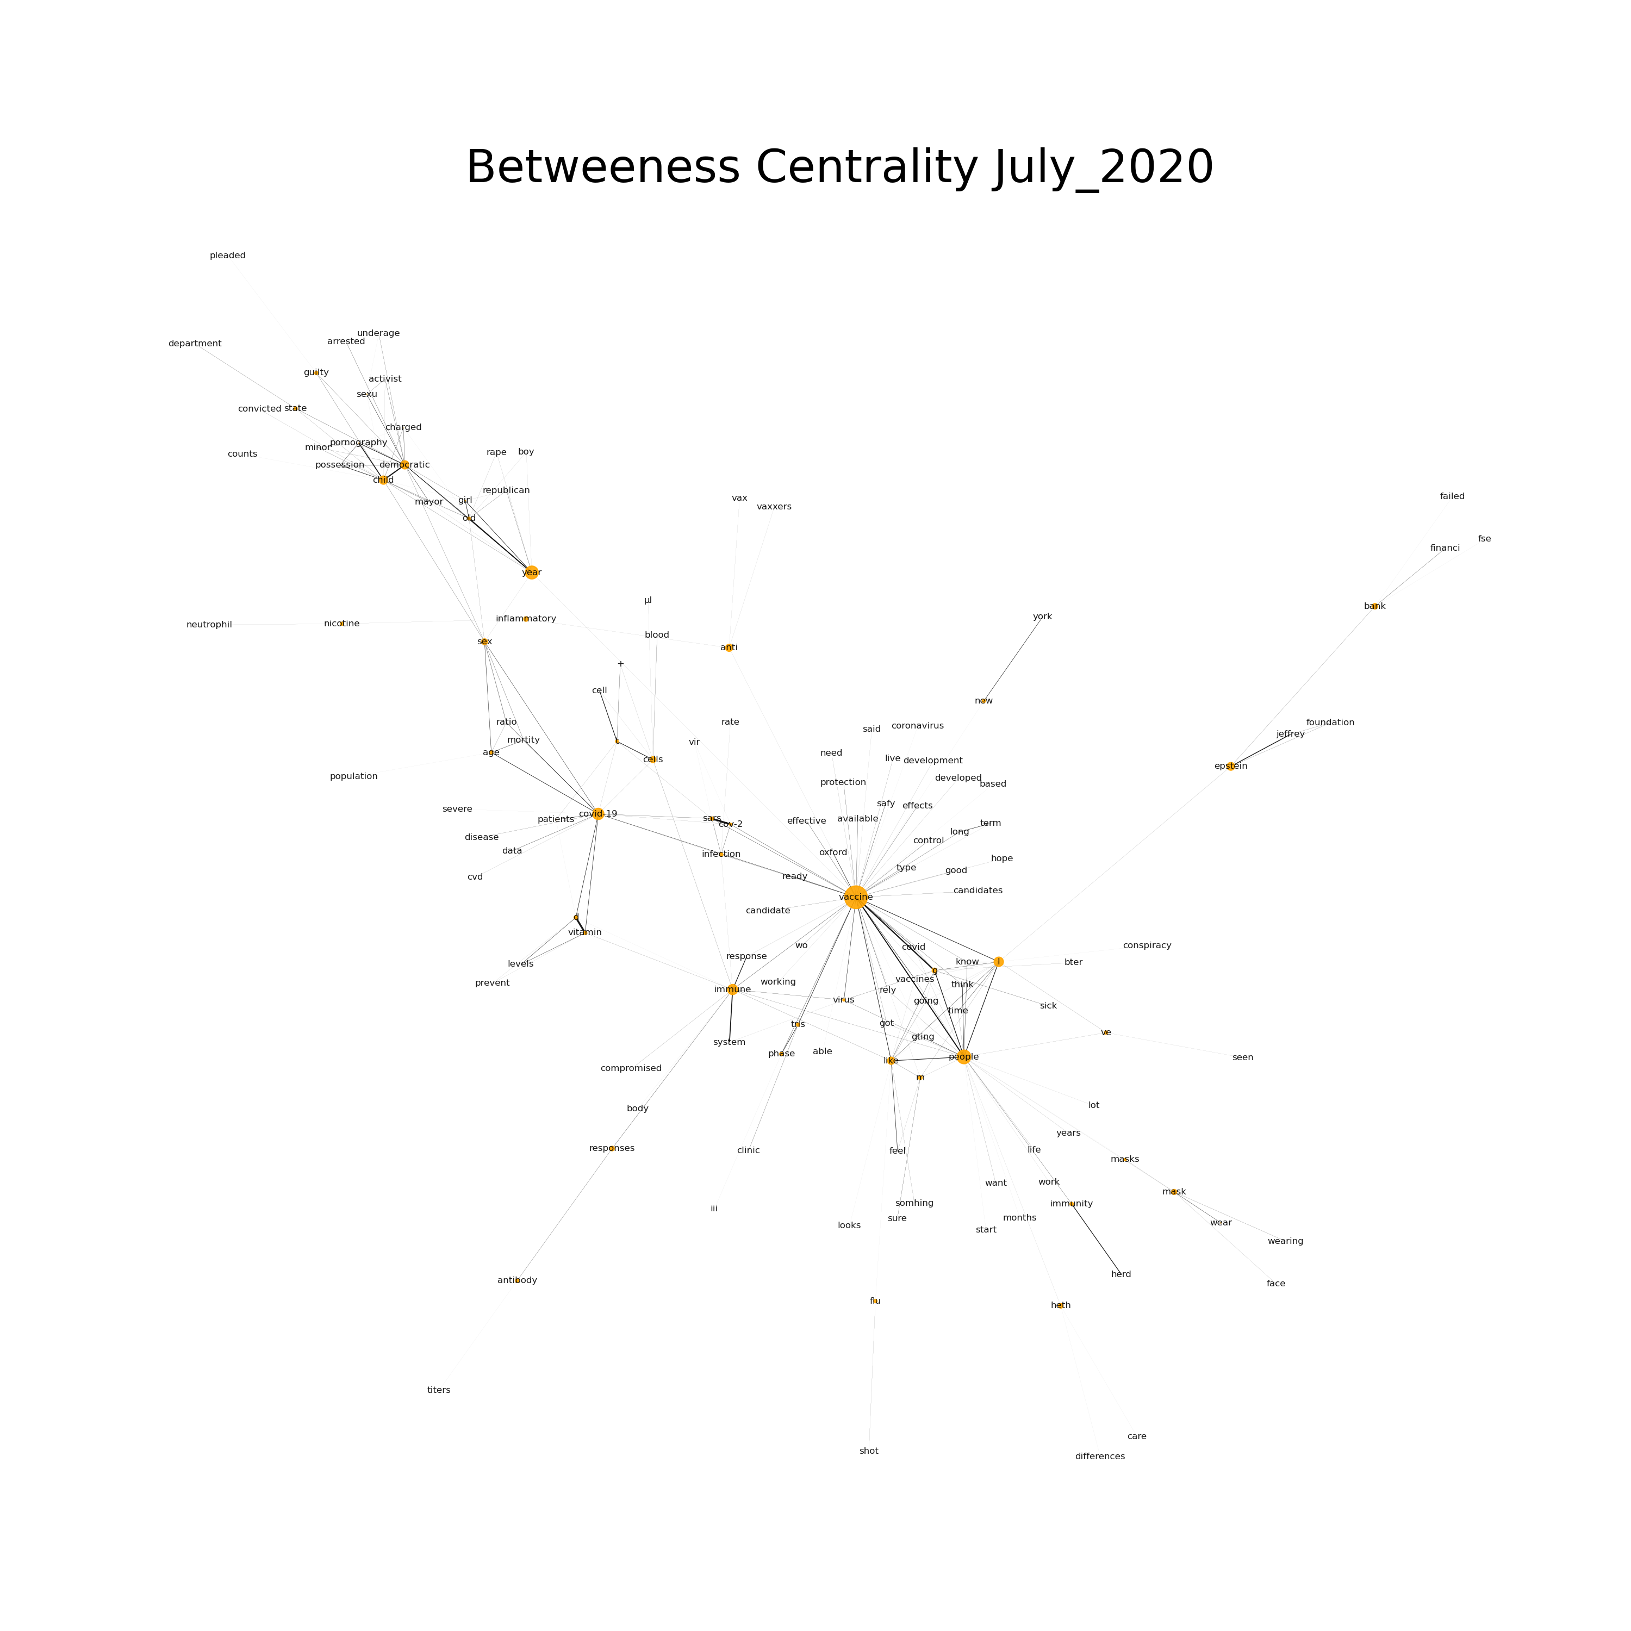
Node | Centrality
vaccine | 0.697154
people | 0.252754
year | 0.224218
covid-19 | 0.170612
immune | 0.137818
l | 0.116801
child | 0.090735
democratic | 0.090444
epstein | 0.081197
like | 0.069847
anti | 0.068182
cells | 0.047911
sex | 0.044946
bank | 0.041375
mask | 0.034479
g | 0.028961
heth | 0.027681
responses | 0.027584
inflammatory | 0.027584
m | 0.019373
d | 0.017244
infection | 0.016164
vitamin | 0.01489
Notes:
Vaccine node overtakes the node “people”. Terms related to covid begin to increase their betweenness centrality. You can observe “covid” connecting to “vaccine” and to covid-19. Also, this graph picked up conspiracy discussions related to covid, Q? Joke about the Epstein node.

Slide 13
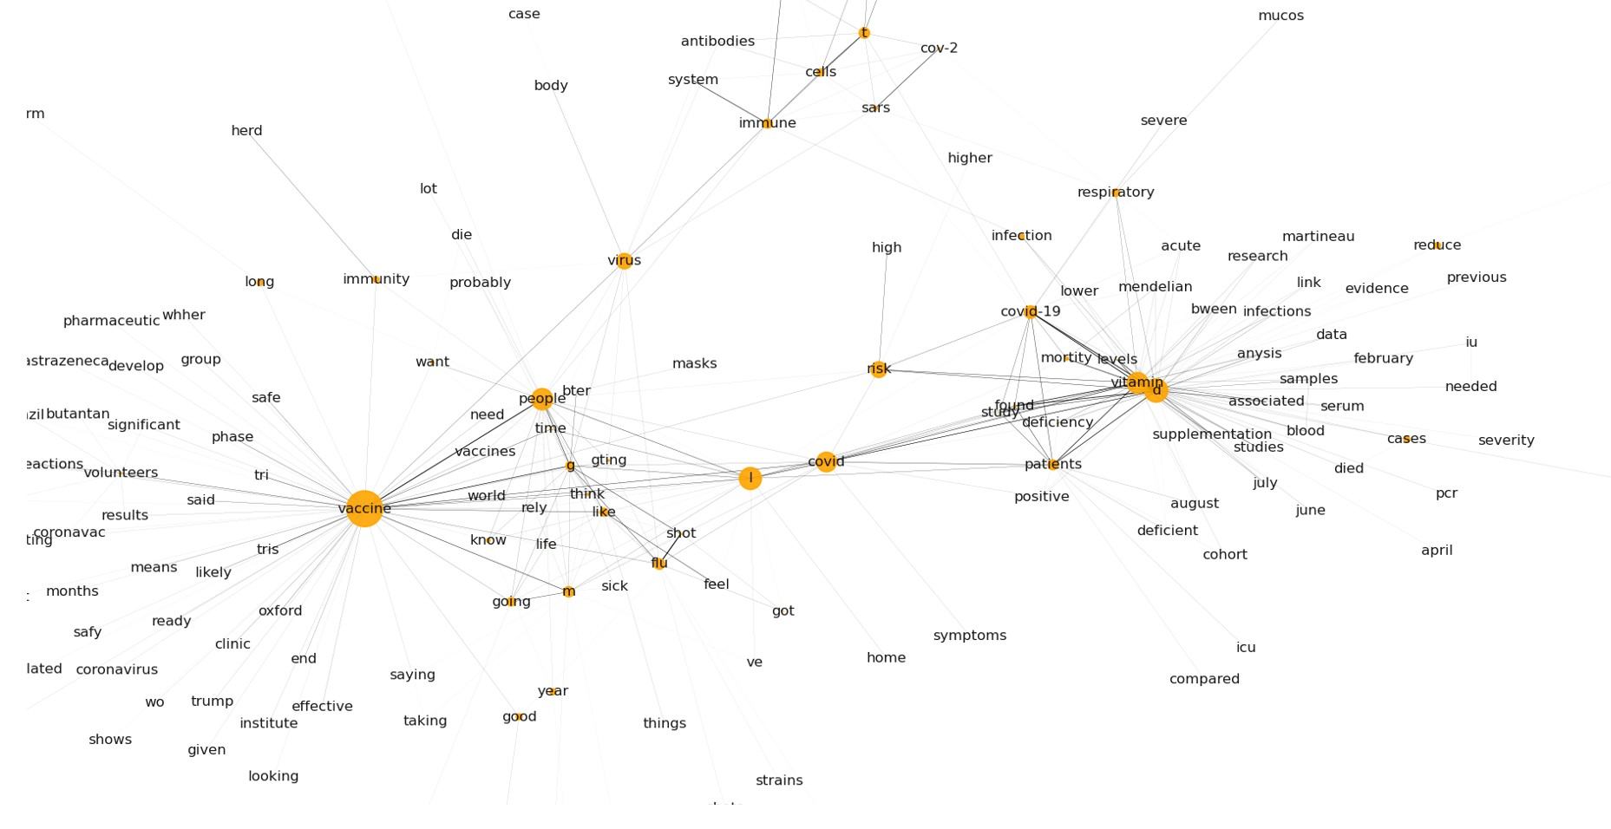
September 2020
Node | Centrality
vaccine | 0.499444
d | 0.204789
l | 0.185408
people | 0.171424
vitamin | 0.164606
covid | 0.147134
risk | 0.093337
virus | 0.089892
wear | 0.059479
covid-19 | 0.058619
mask | 0.048257
flu | 0.041449
t | 0.039851
m | 0.039147
patients | 0.035534
immune | 0.030367
anti | 0.024315
going | 0.024266
g | 0.024205
like | 0.022553
respiratory | 0.019605

Slide 14
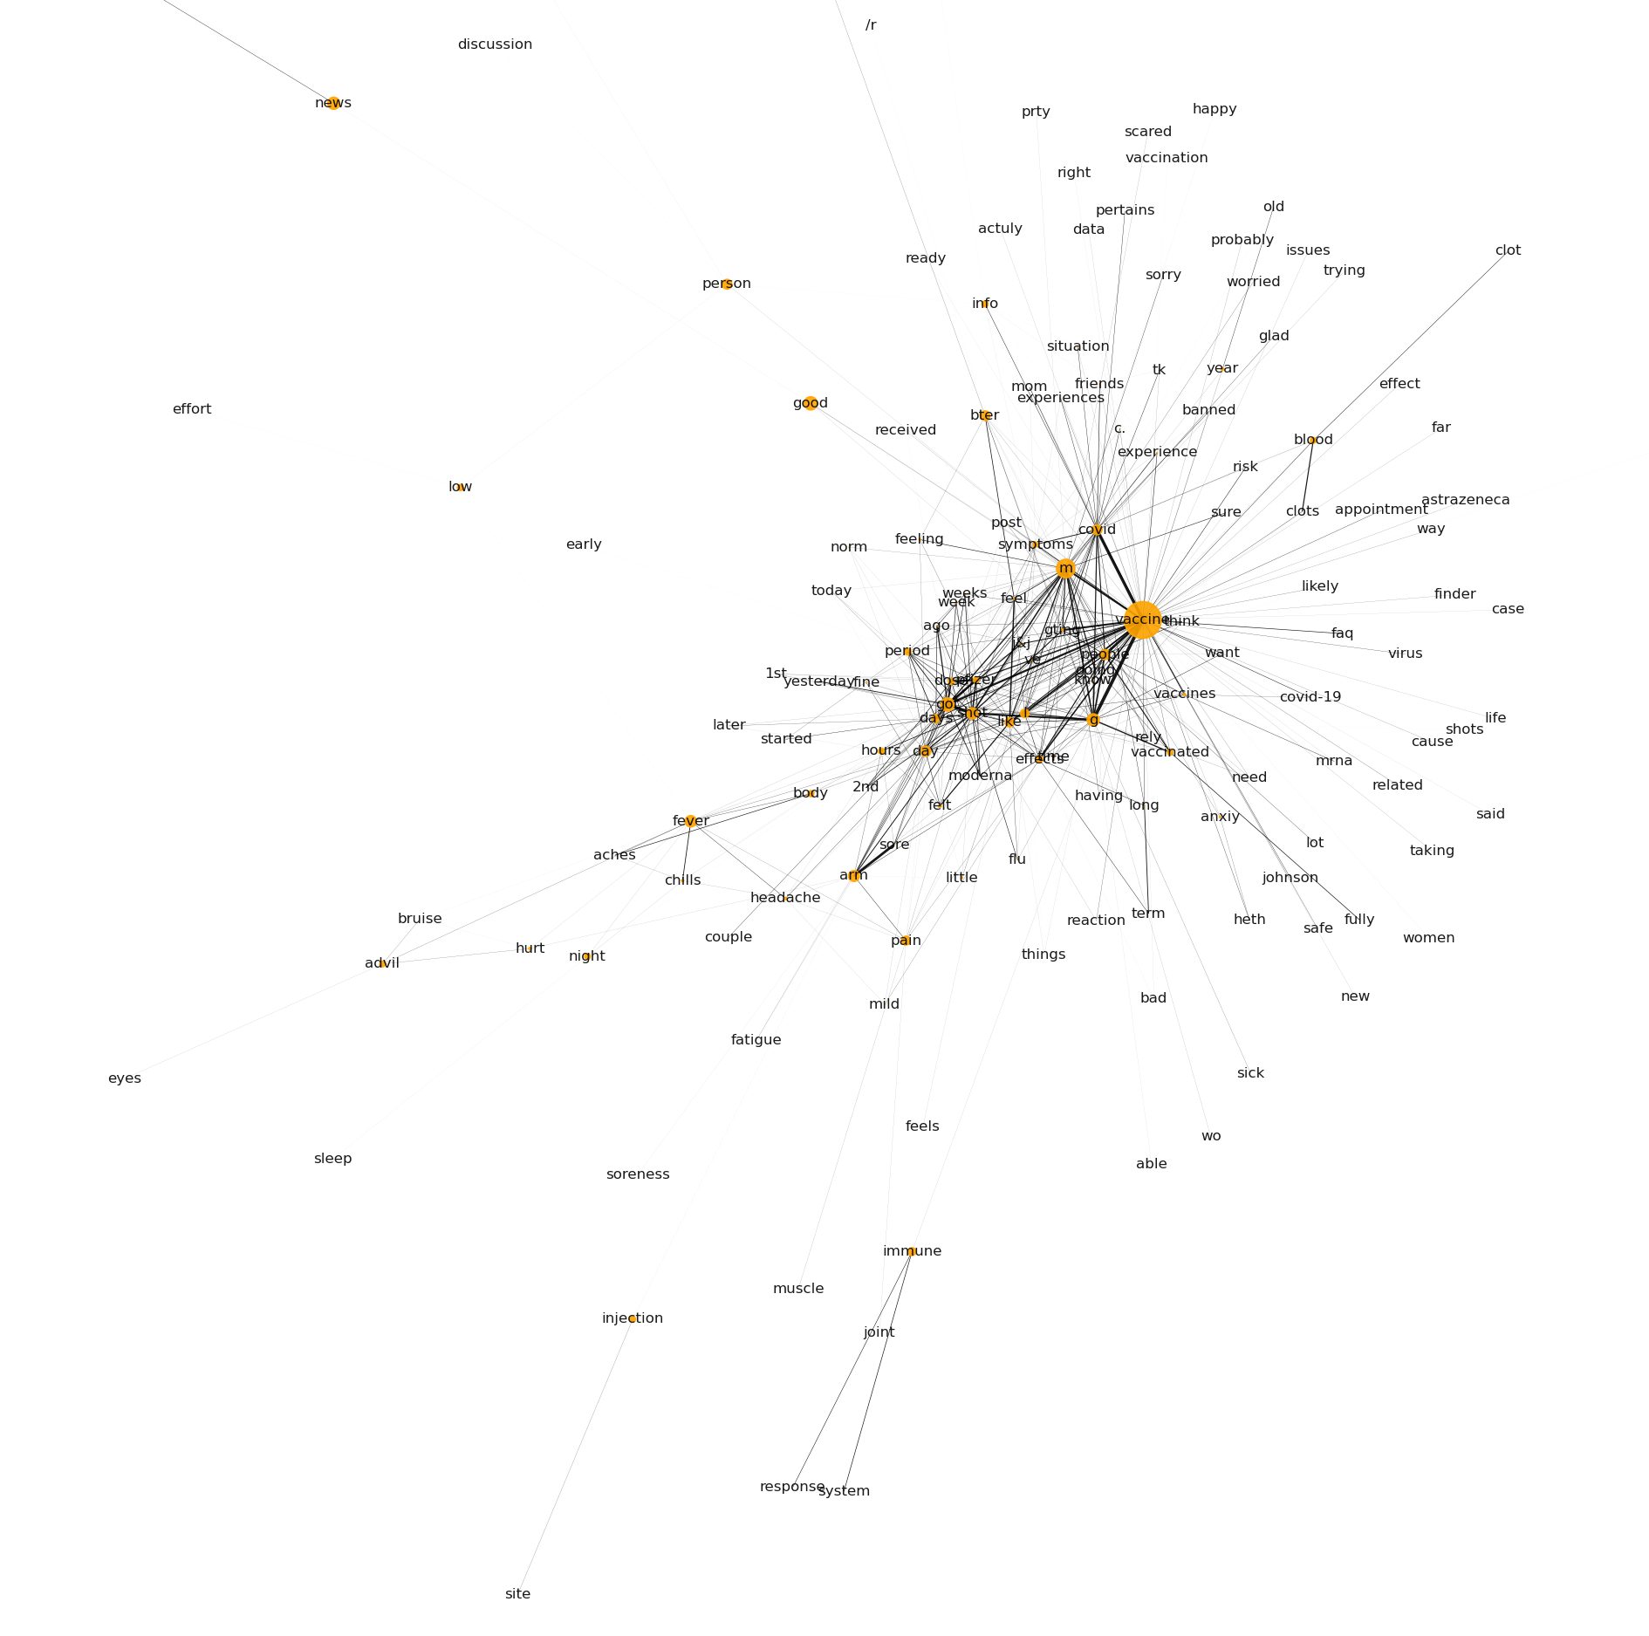
Betweenness Centrality:
April 2021
Node | Centrality
vaccine | 0.585786
m | 0.145422
got | 0.073577
good | 0.072205
g | 0.061462
news | 0.060559
fever | 0.05323
shot | 0.051778
sources | 0.049224
arm | 0.049135
day | 0.043424
people | 0.041782
covid | 0.03939
person | 0.038812
bter | 0.038065
action | 0.036801
like | 0.034818
pain | 0.031612
l | 0.02864
days | 0.026567
immune | 0.024767
effects | 0.018163
Notes:
As vaccines become more available, discussion overwhelmingly shifts to accounts of side-effects and emotional responses…some hesitant, some happy about vaccines

Slide 15
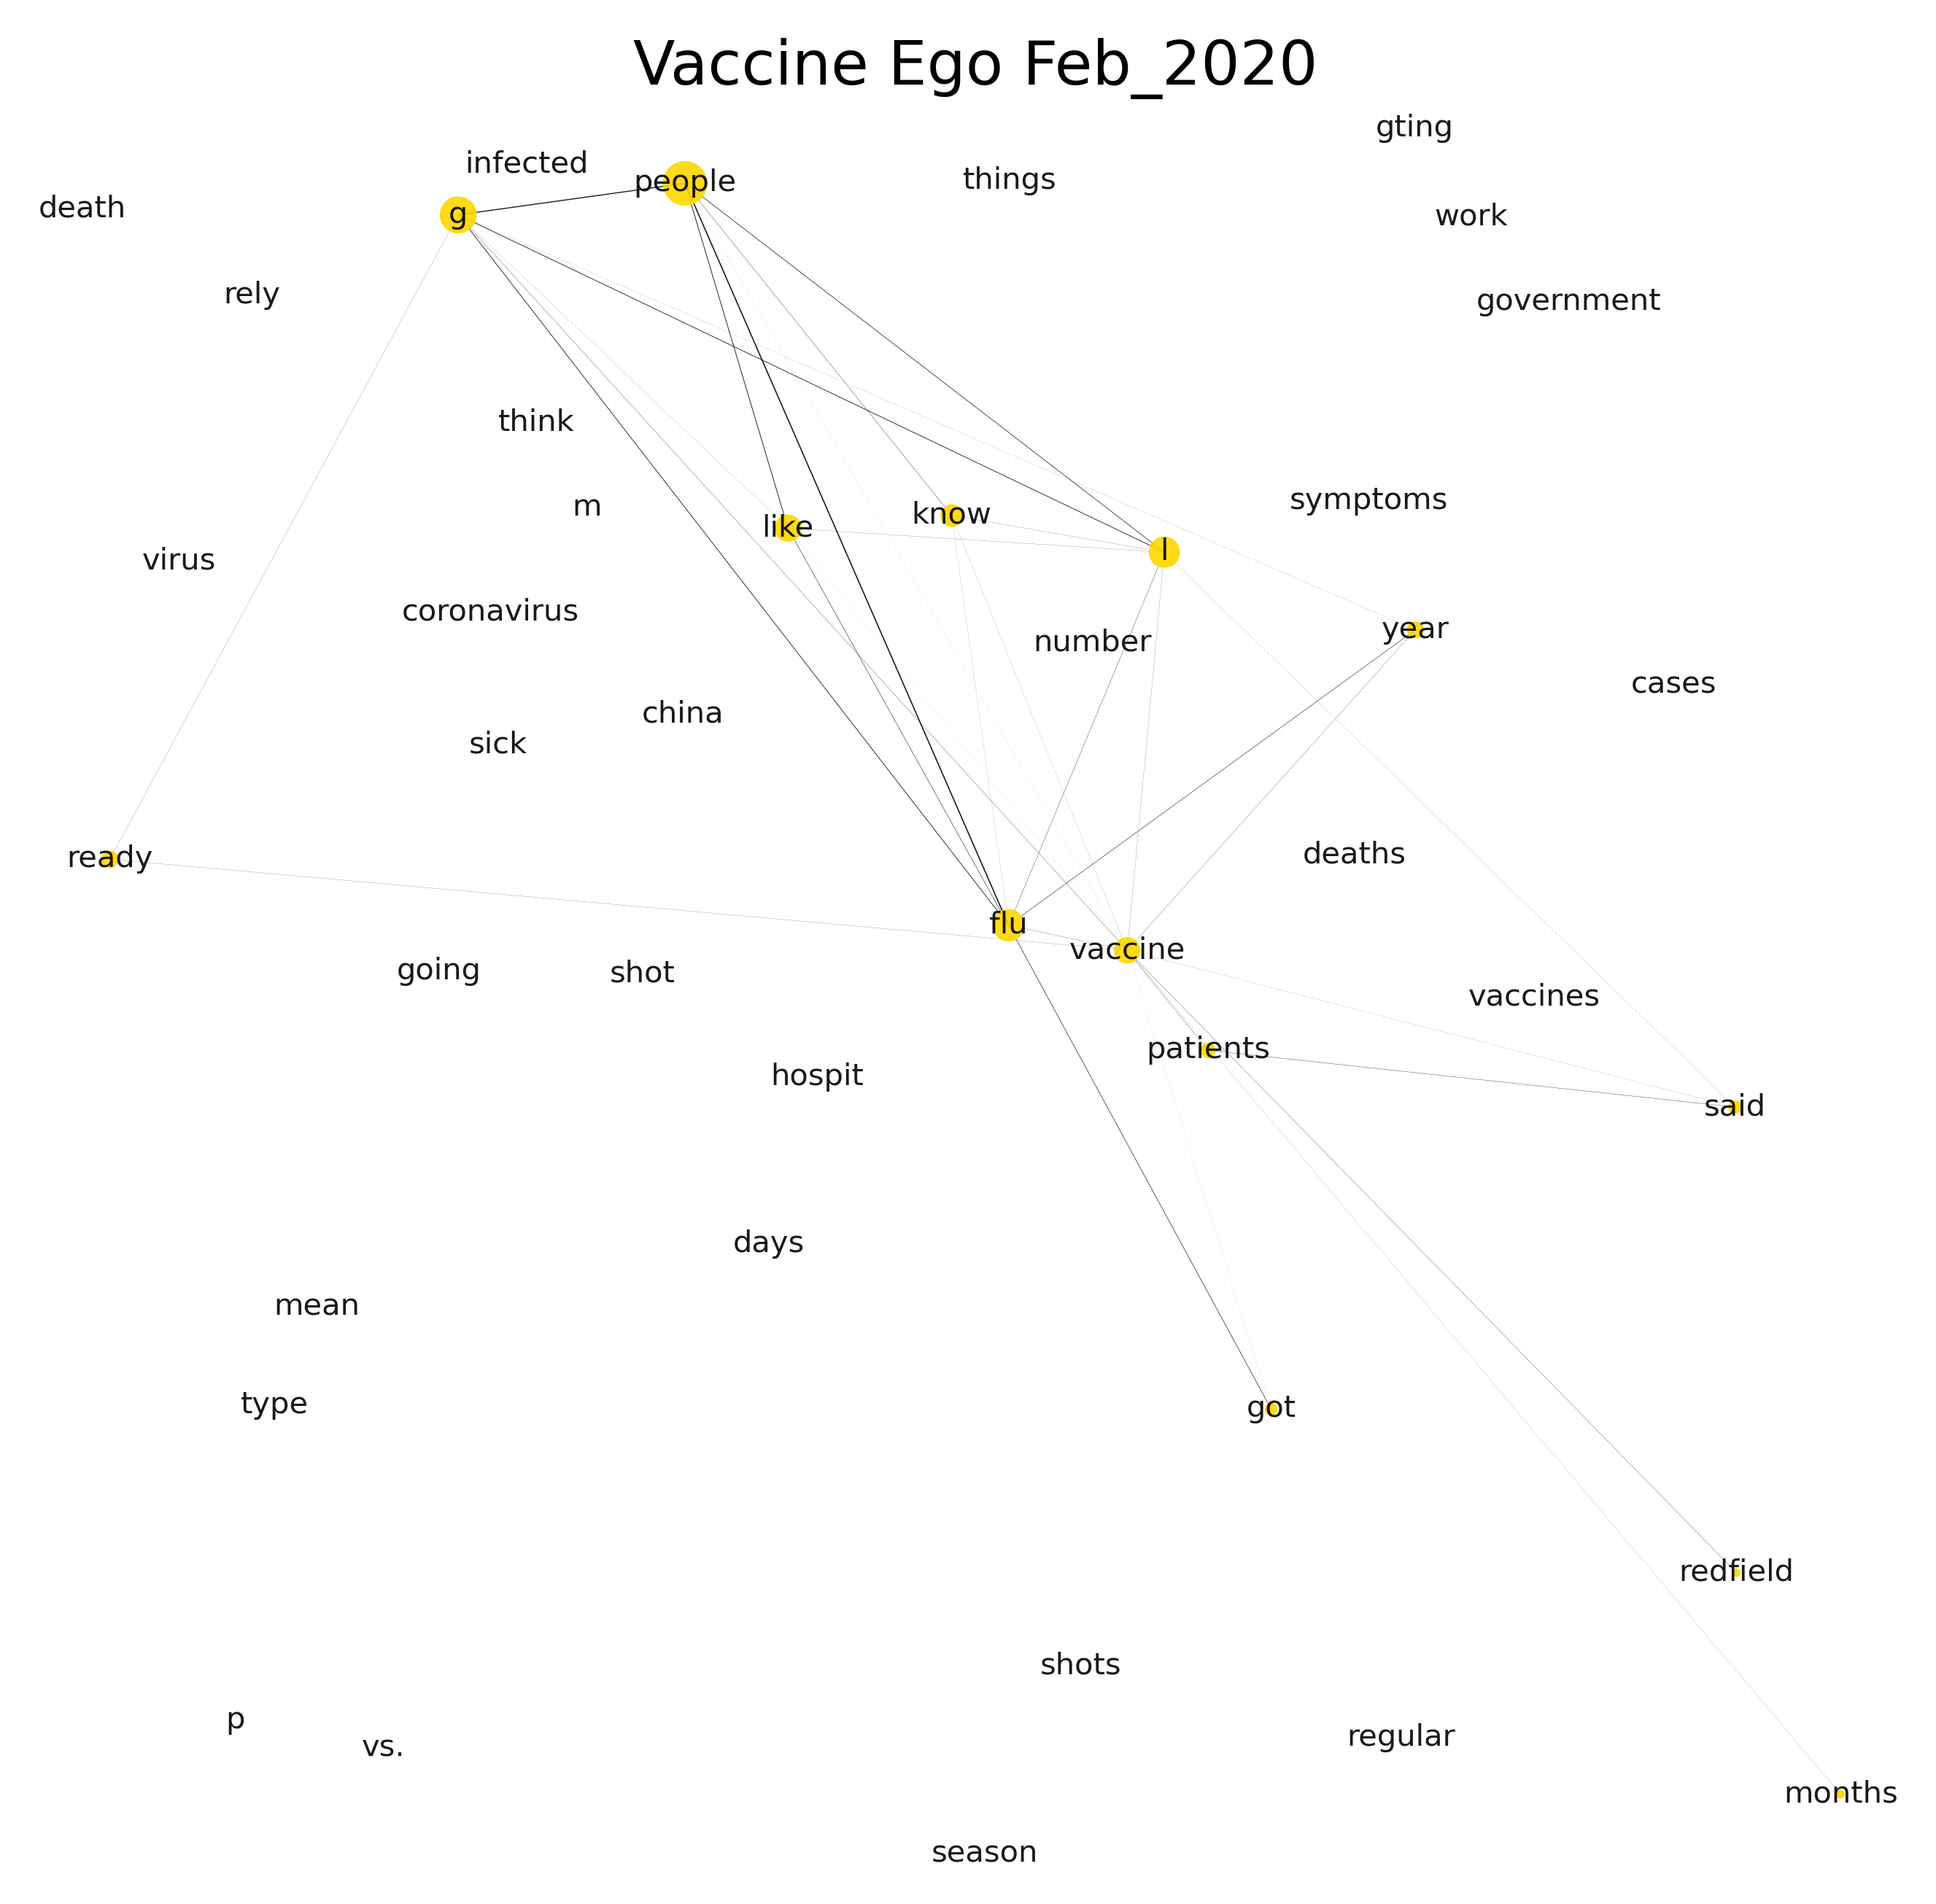
Notes:
A similar story is reflected with the ego networks. Coronavirs is very faint here and vaccine discussions appeared to focused on the flu vaccine.

Slide 16
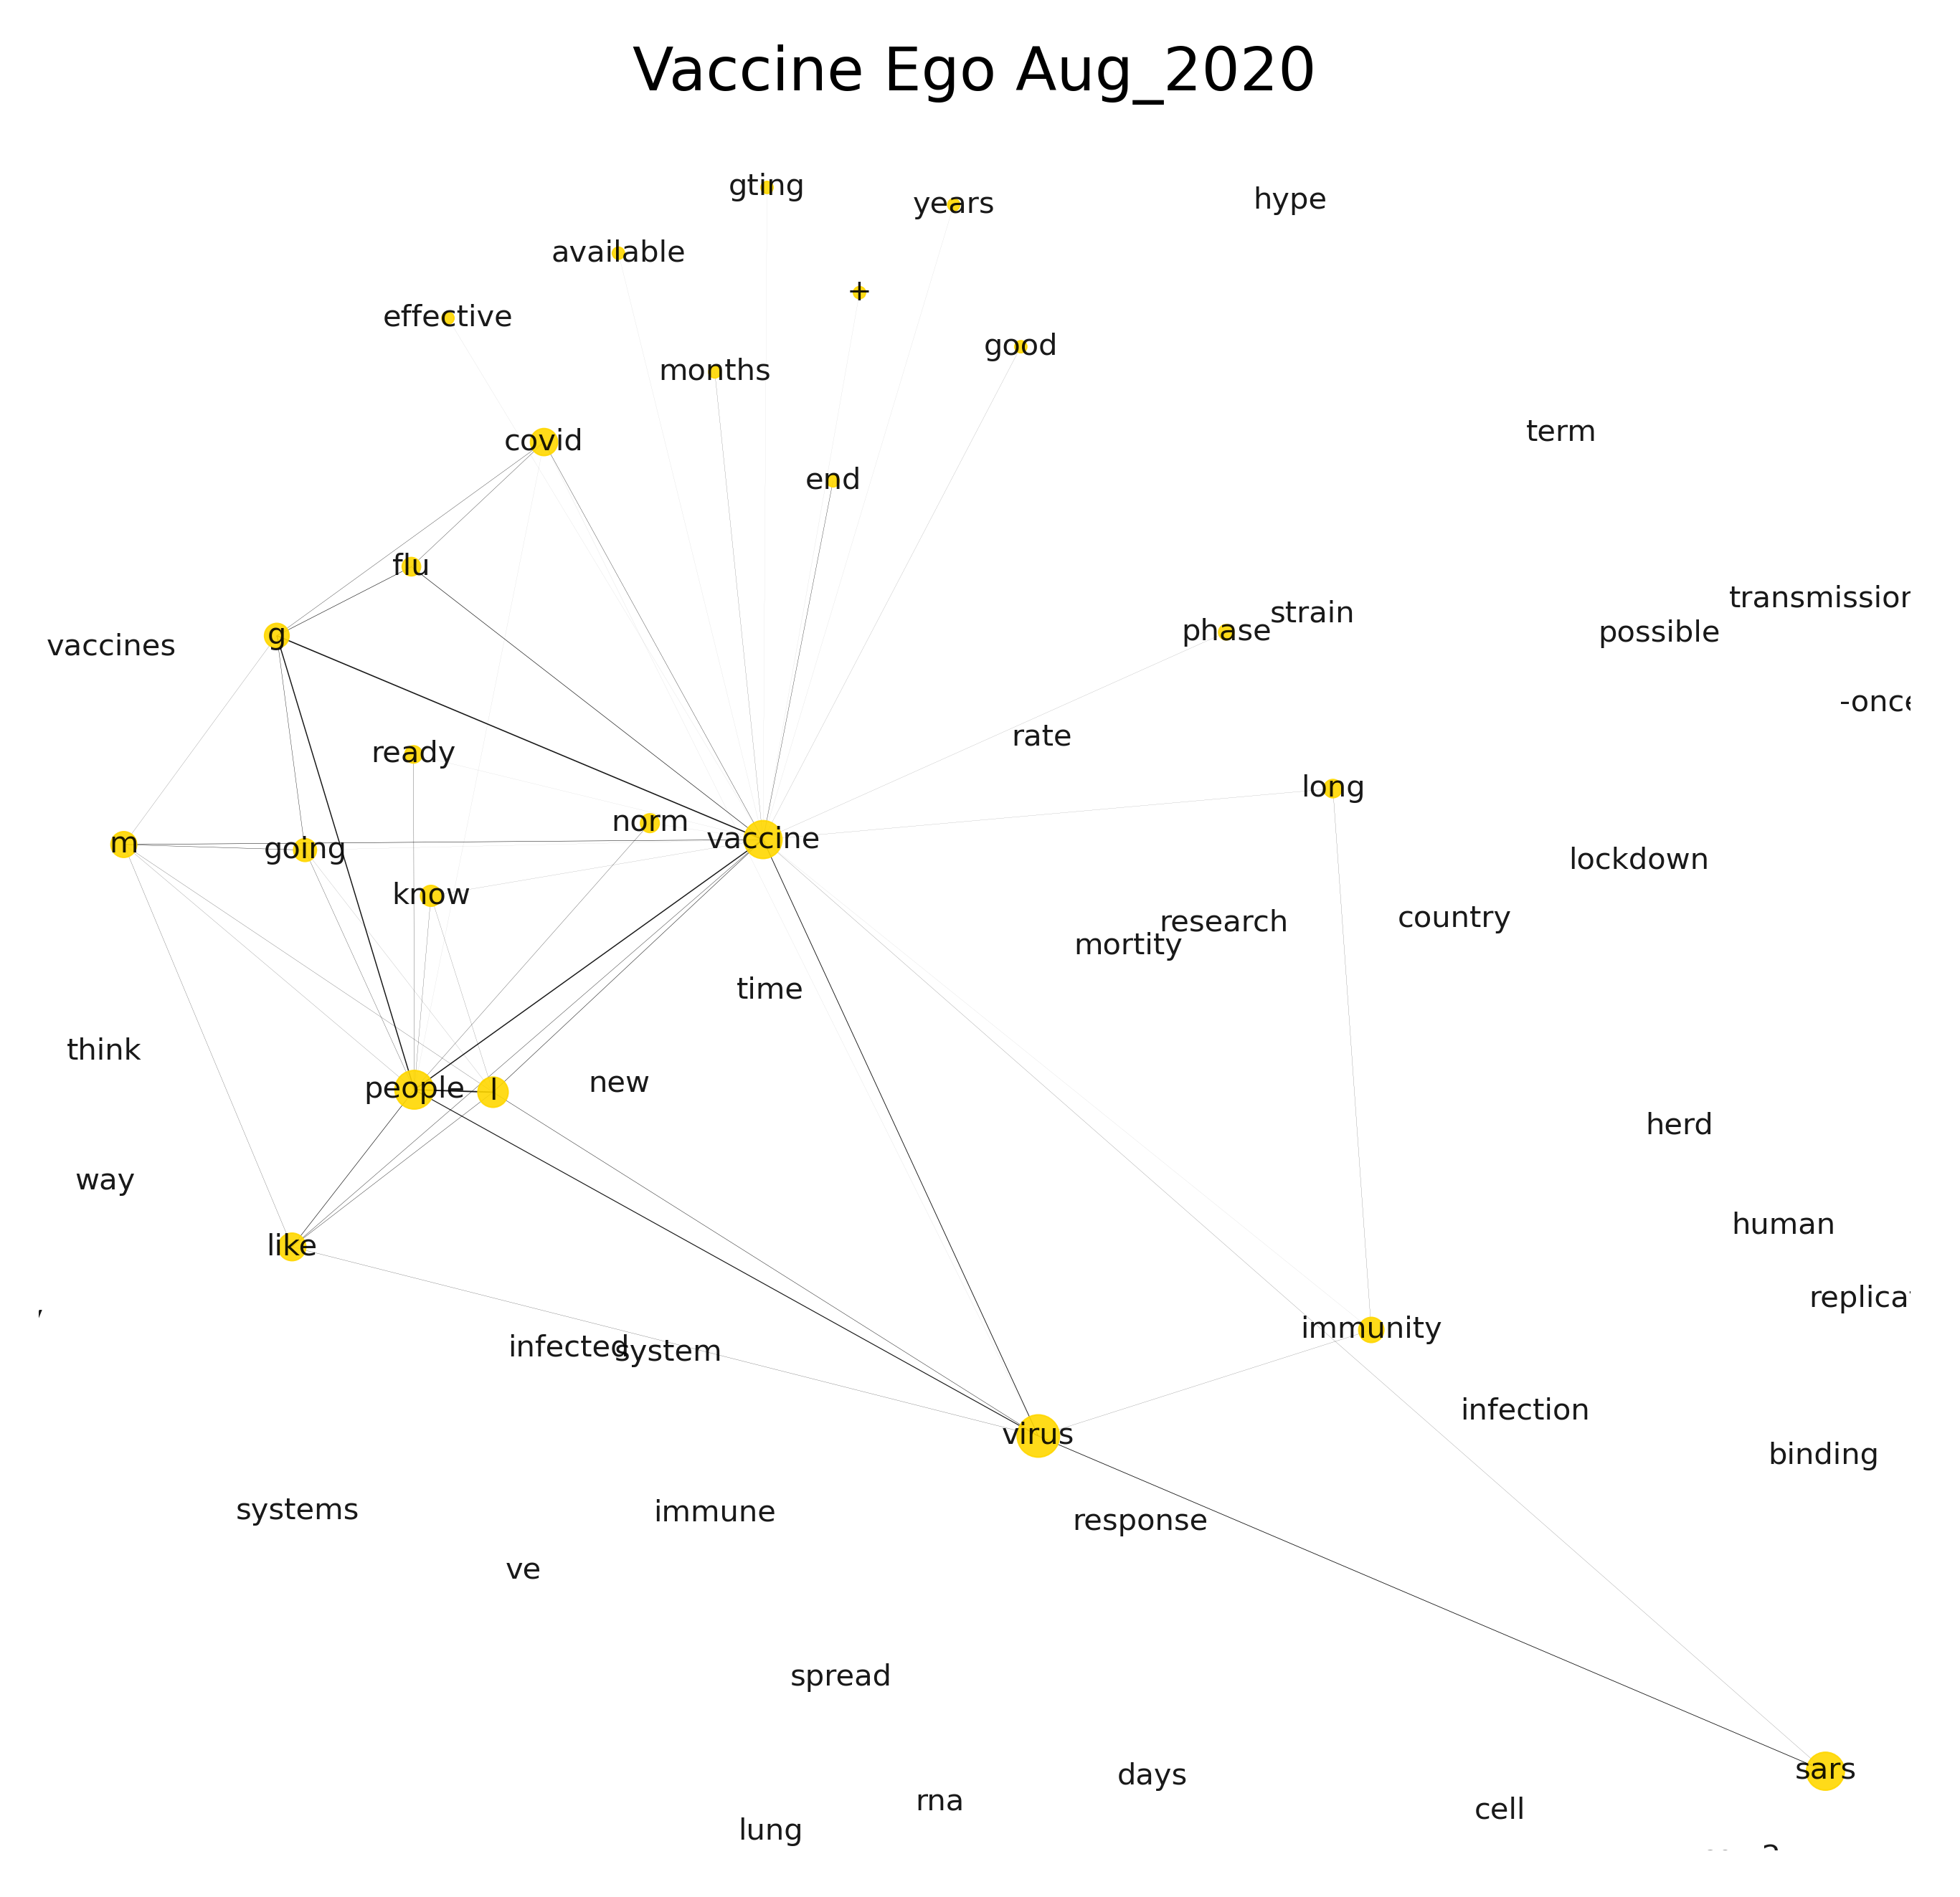
Notes:
Flu is still prevalent but covid related terms are beginning to appear.

Slide 17
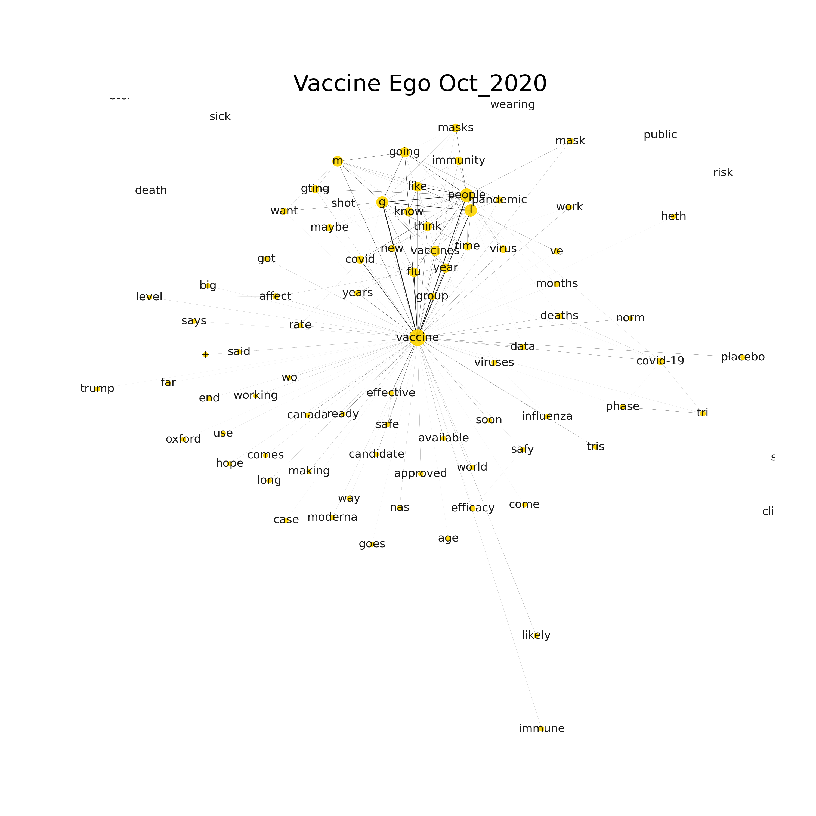
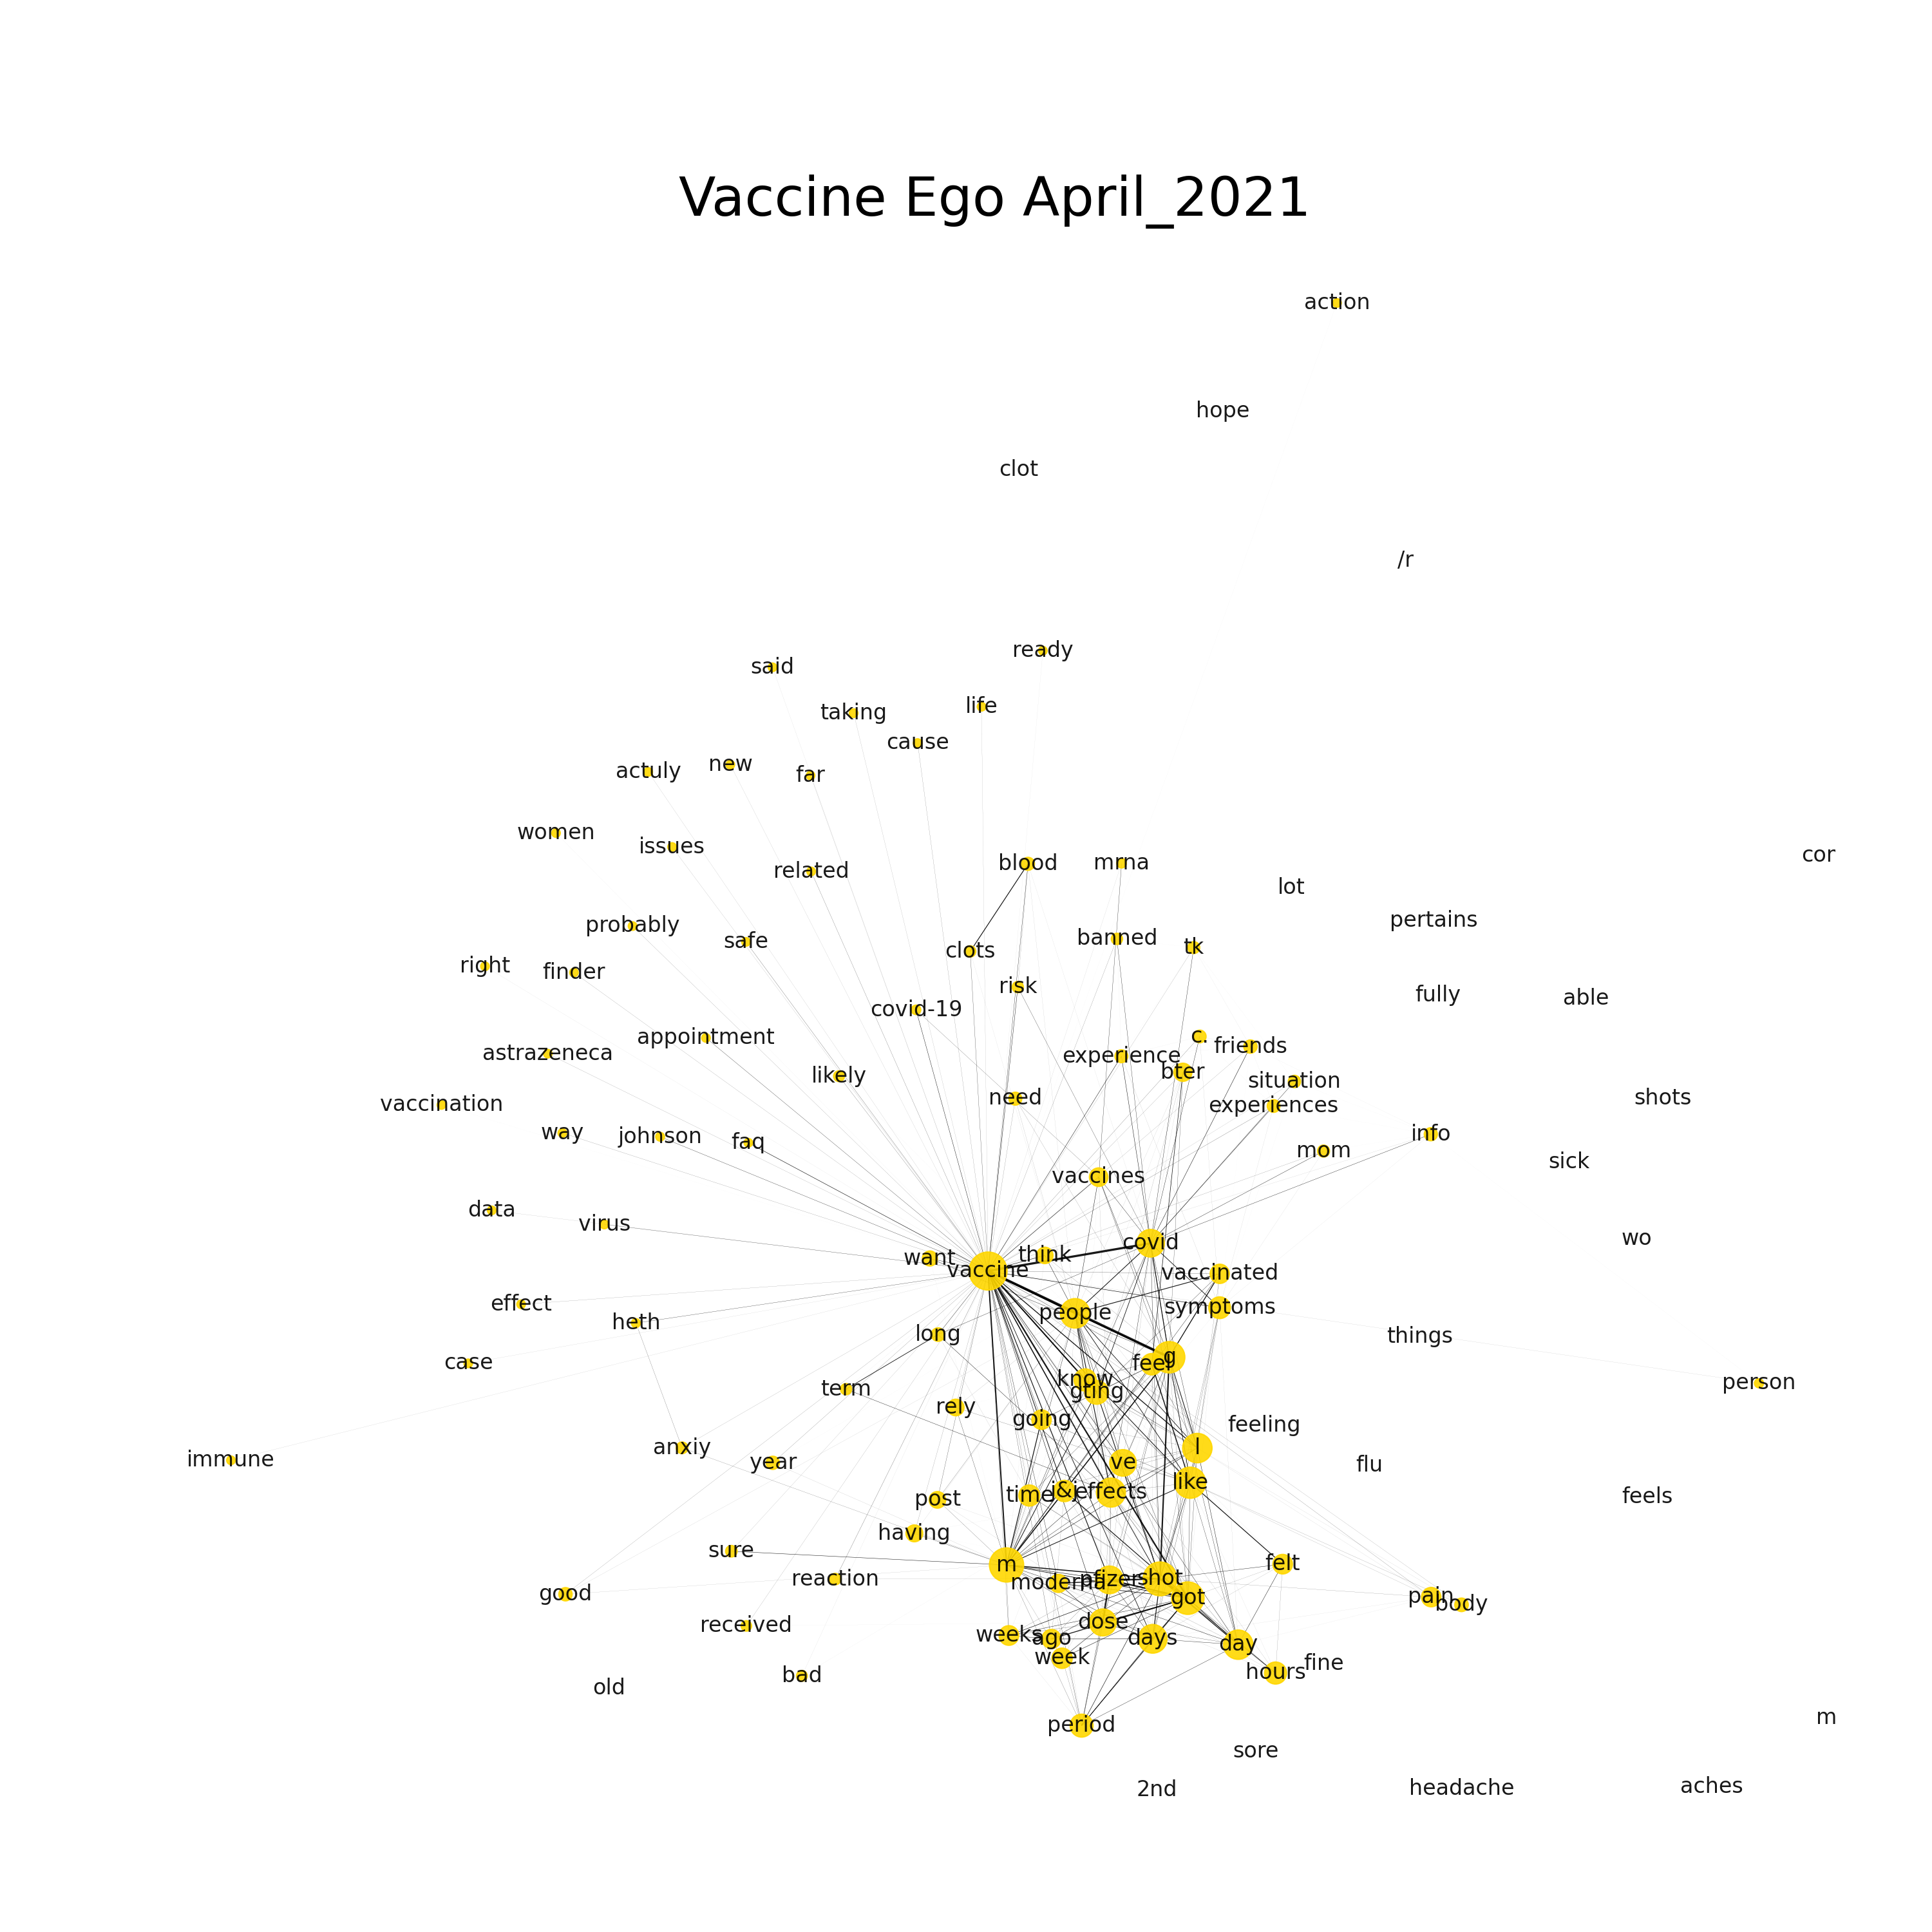

Slide 18
Conclusions and Future Work
We created betweenness centrality networks using approximately 31,000 comments/posts harvested from 12 subreddits.
Our analysis found mentioning of COVID-19 vaccine misinformation/disinformation, vaccine-hesitant content, and discussion of side-effects.
Sentiment analysis and topic modeling with BERT .
Comparative analysis between COVID-19 vaccine related Reddit and Twitter data.
github.com: Cheltone/W3PHIAI-2022
chadmeltone@gmail.com

Slide 19
Thank you! Questions?
github.com: Cheltone/W3PHIAI-2022
chadmeltone@gmail.com

Slide 20
Network Supplementary
Betweenness centrality measures the number of times a node lies on the shortest path between other nodes. (i.e., nodes bridge a network together. Ideal for communication networks).
Eigenvector centrality measures node influence based on quantity of connections to other nodes (ideal for social networks) .
Degree centrality is determined by number of links held by each node (how many connections… frequency of connections for nodes).

Slide 21
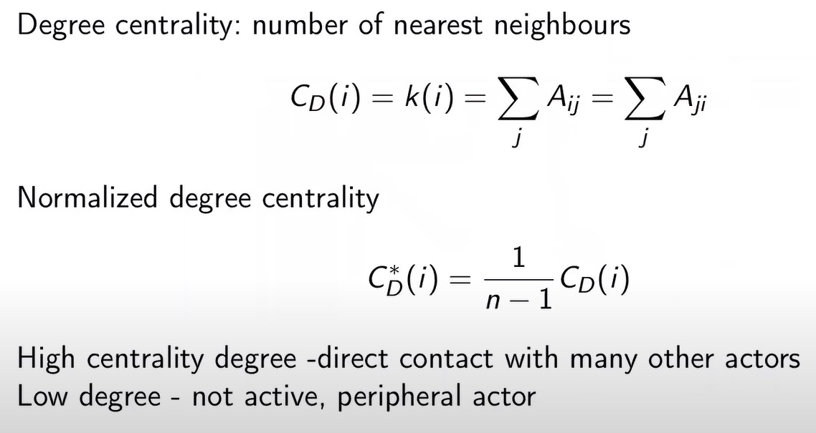
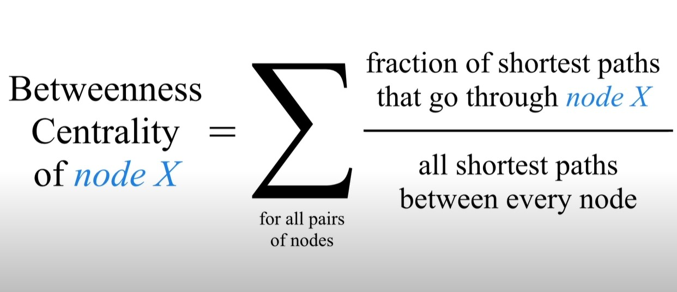
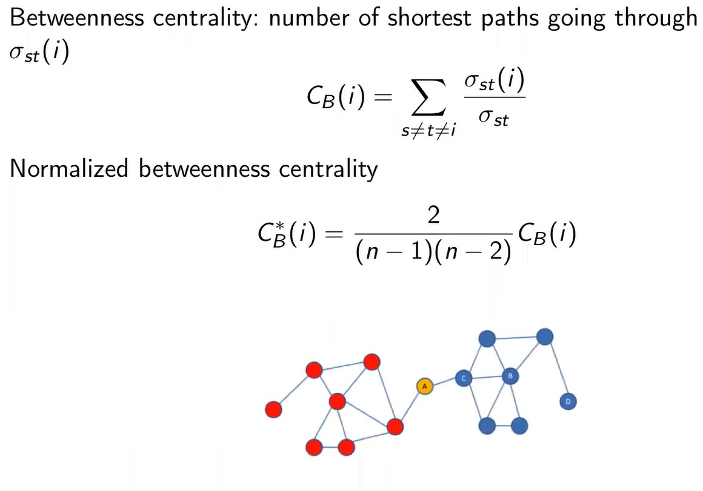
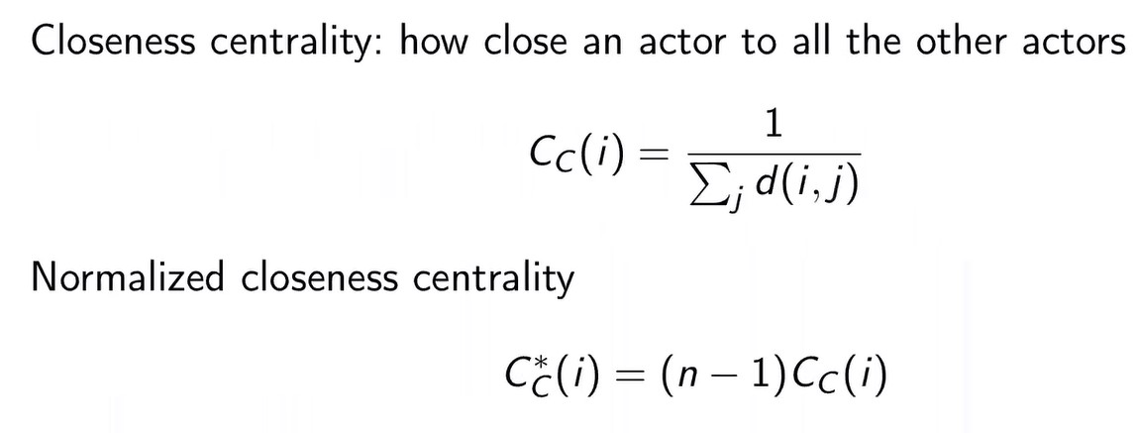
Centrality Calculations

Slide 22
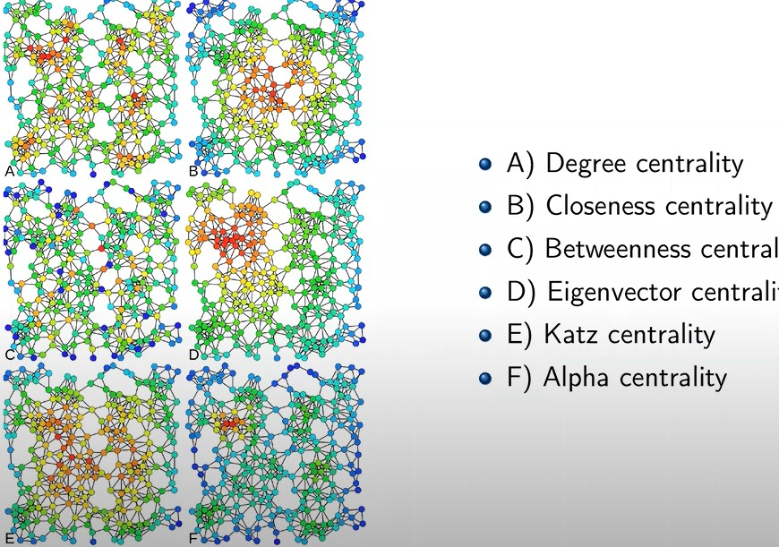

Slide 23
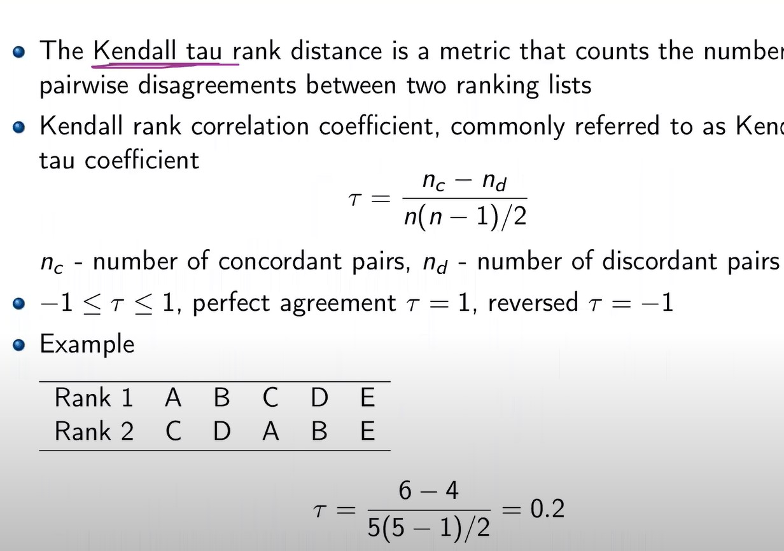
Network metrics
Kendall Tau: for ranking disagreements.

Slide 24
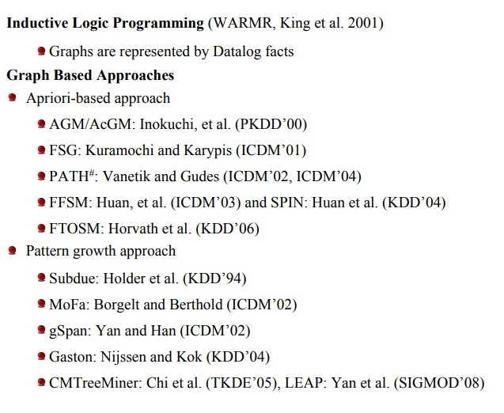
Graph mining
Pattern frequency
Fisher Score: the gradient
or the derivative of the log likelihood
function
Significance: G-Test

